Slide 1
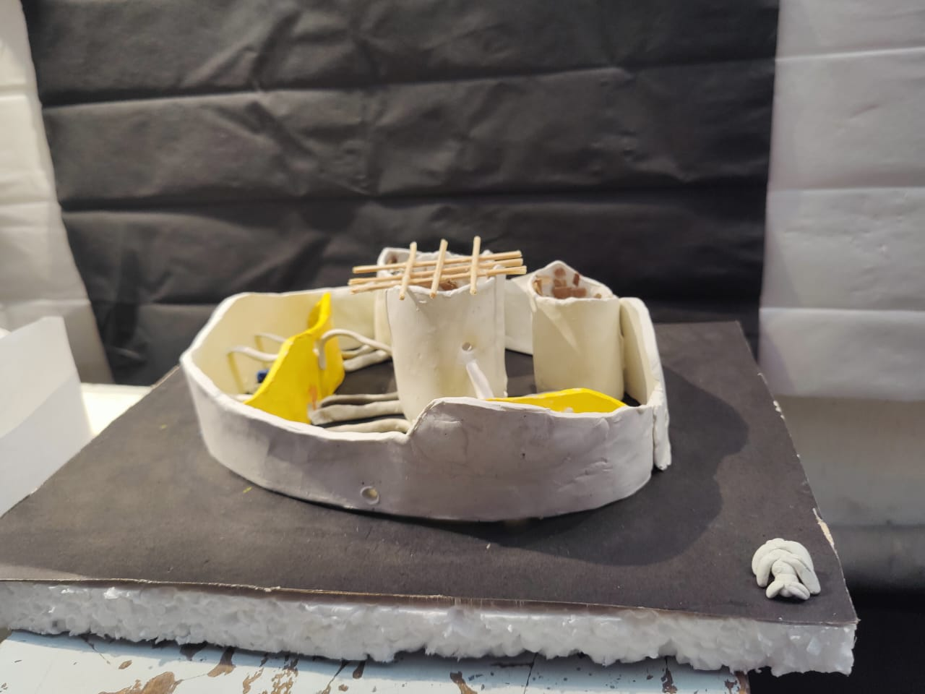

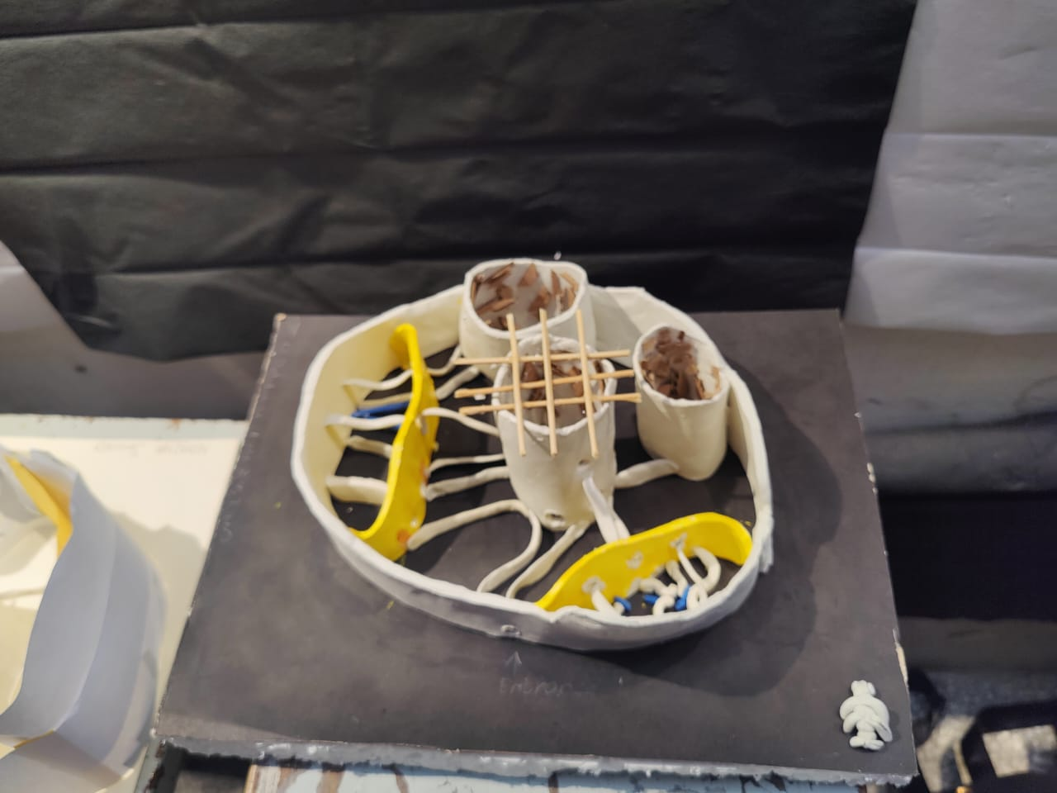
Interior Spaces
The inside areas of a modle is design according to our character (ant) . The spaces are interconnected with each other.

